Slide 1
Python
Kay Kasemir
July 2026

Slide 2

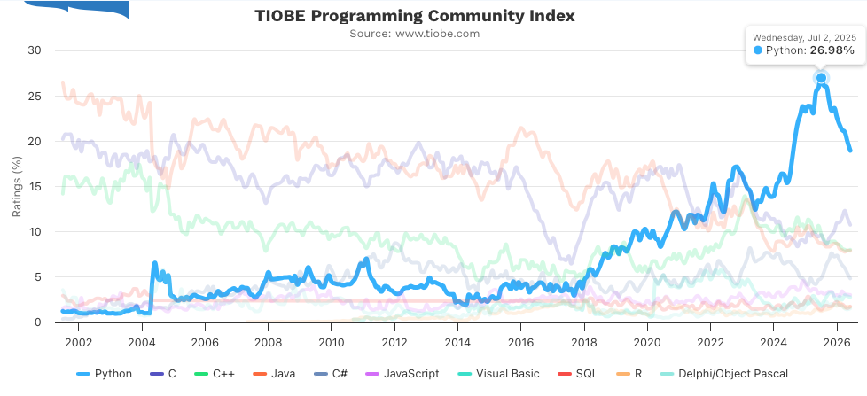
Python
Is very popular
Can be very powerful
Is comparably easy to learn
Is a scripting language
  Great for quick scripts
  No type safety
  No compilation & linking of the complete program
  Terrible for larger code that is to be maintained for a long time

Slide 3
Python and EPICS
 | Channel Access | PV Access
Client | PyEPICS | P4P
Server | PCASPY, PyDevice | P4P, PyDevice

Slide 4
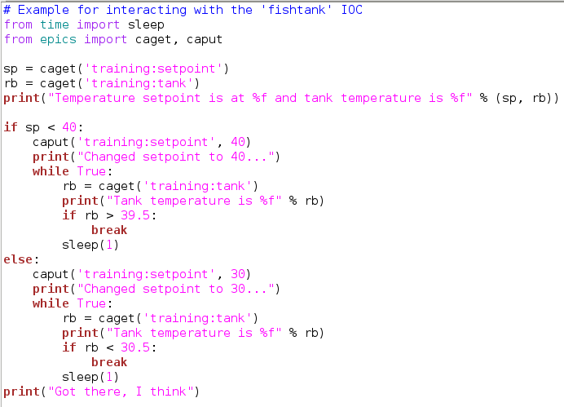
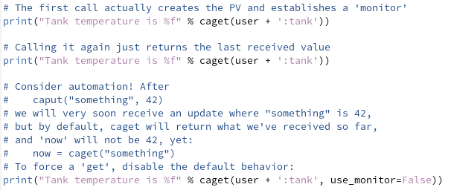
PyEPICS: Channel Access Client
Easiest ‘caput’, ‘caget’
type of client
  Keeps all used channels open
  ‘caget’ will internally ‘monitor’
  Tends to give best performance for simple scripts
Also offers low level “PV” API
  https://pyepics.github.io/pyepics
See /ics/examples/19_python/ca*.py

Slide 5
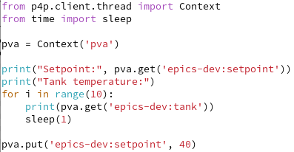

P4P: PVA Access Client
.. and Server
Provides “PV” type API, no caching or internal monitoring as in PyEPICS
  https://epics-base.github.io/p4p
See /ics/examples/15_pvaccess/*.py

Slide 6

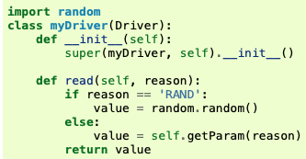

PCASPY: Channel Access Server
Creates Channel Access channels
  Support DBR_DOUBLE, DBR_CTRL_DOUBLE, ..
  GUIs can show value with time stamp, units, precision, …
There is no IOC, no “records”
  No SCAN, DESC, EGU, PREC, CALC, INP, … fields
https://pcaspy.readthedocs.io

Slide 7
PyDevice
Python interface for records on an IOC
IOC may be accessed via CA or PVA
→ Now best option for a CA or PVA server,
see next presentation

Slide 8
Summary
There are CA and PVA client and server modules for Python
For dependable automation, remember get/put-callback
  .. See busy record

